Slide 1



HorizonViewers
Teaching kids about eclipses

Slide 2

Problem
Kid friendly educational platforms
The need for the children to get accurate, scientific answers.
A kids friendly activity center

Slide 3
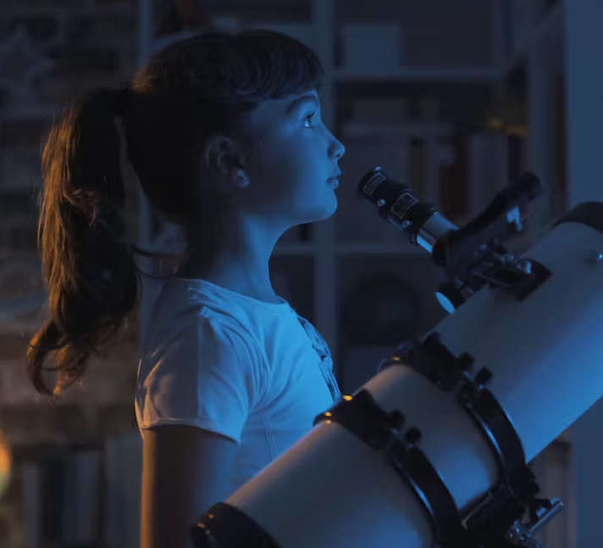
Importance
Spark curiosity
Nurture a scientific understanding of eclipses in young minds

Slide 4
How we solved this chalange ?
Informative content
Application
Hands-on creativity
Quizzes
Live streams
ChatBot

Slide 5
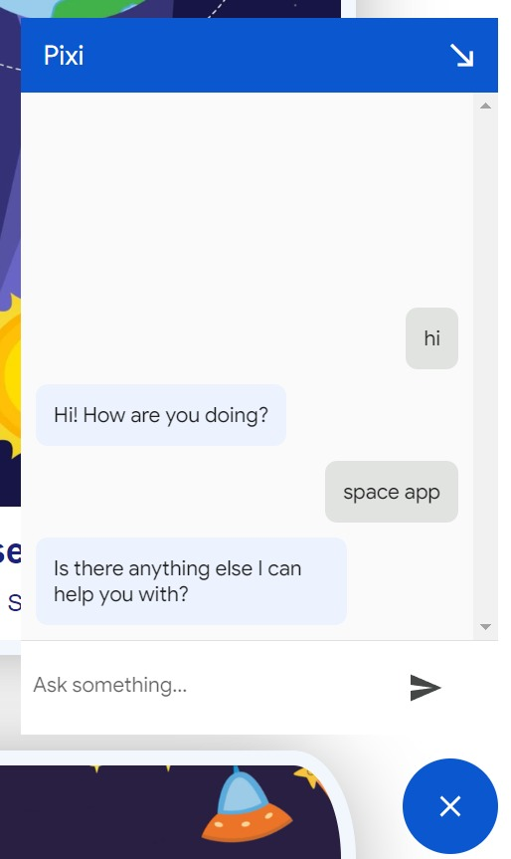
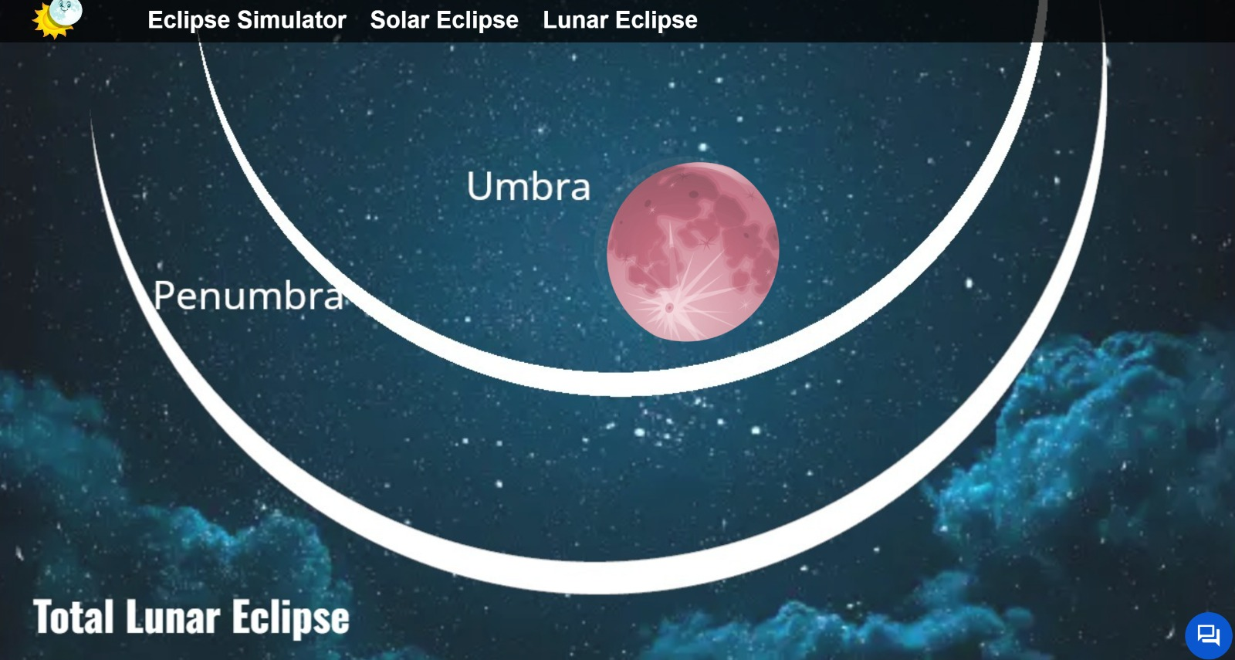
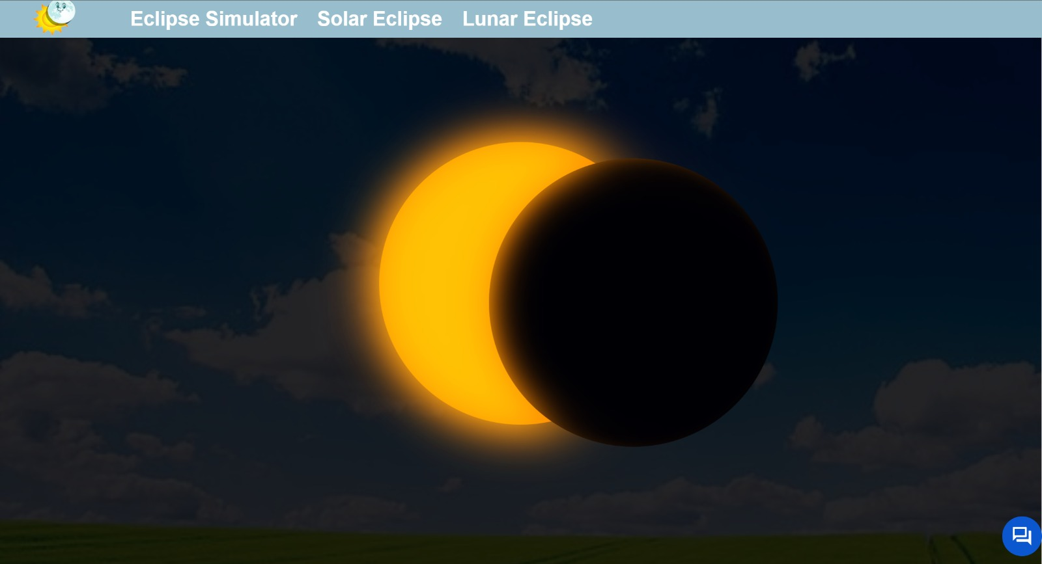

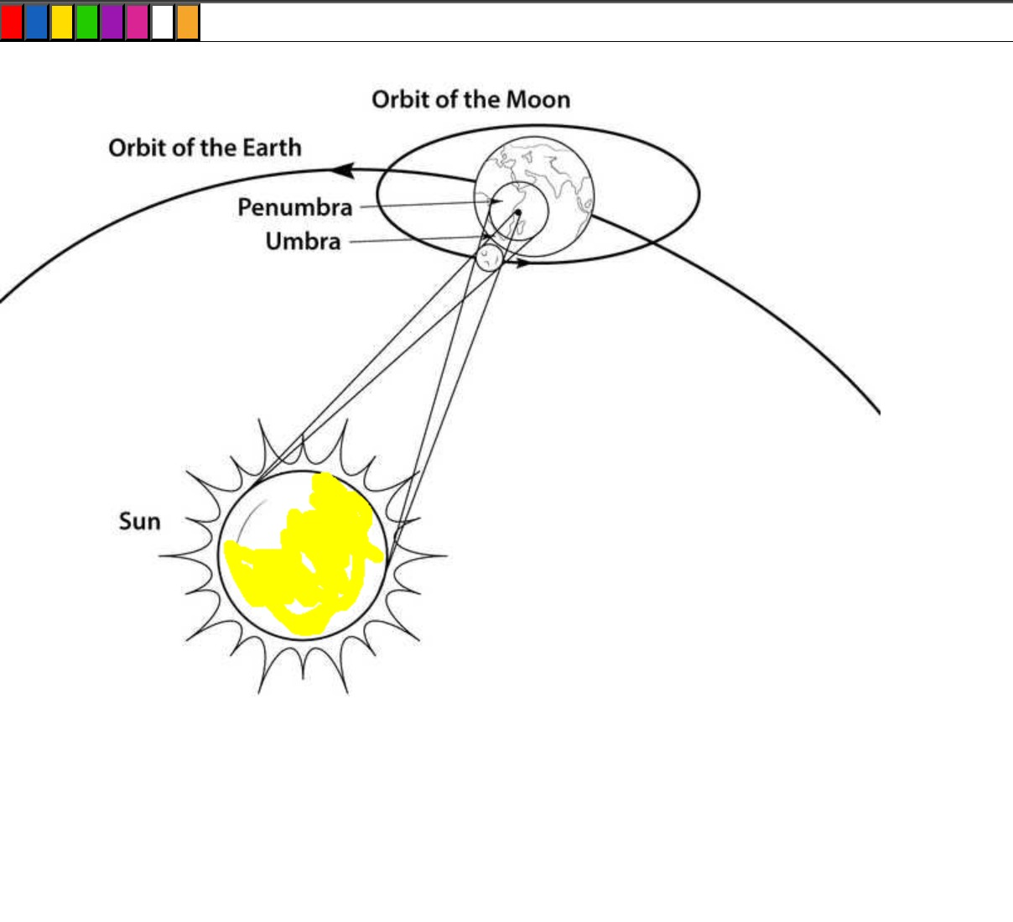
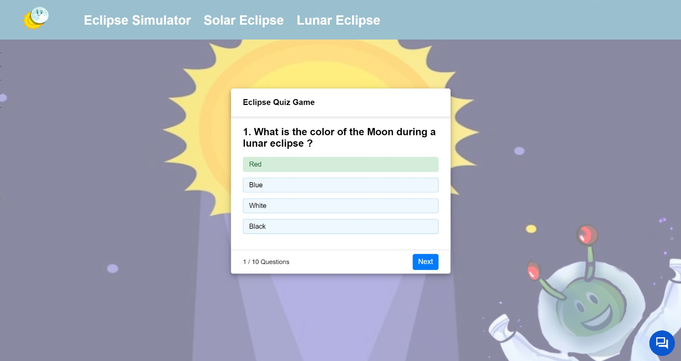
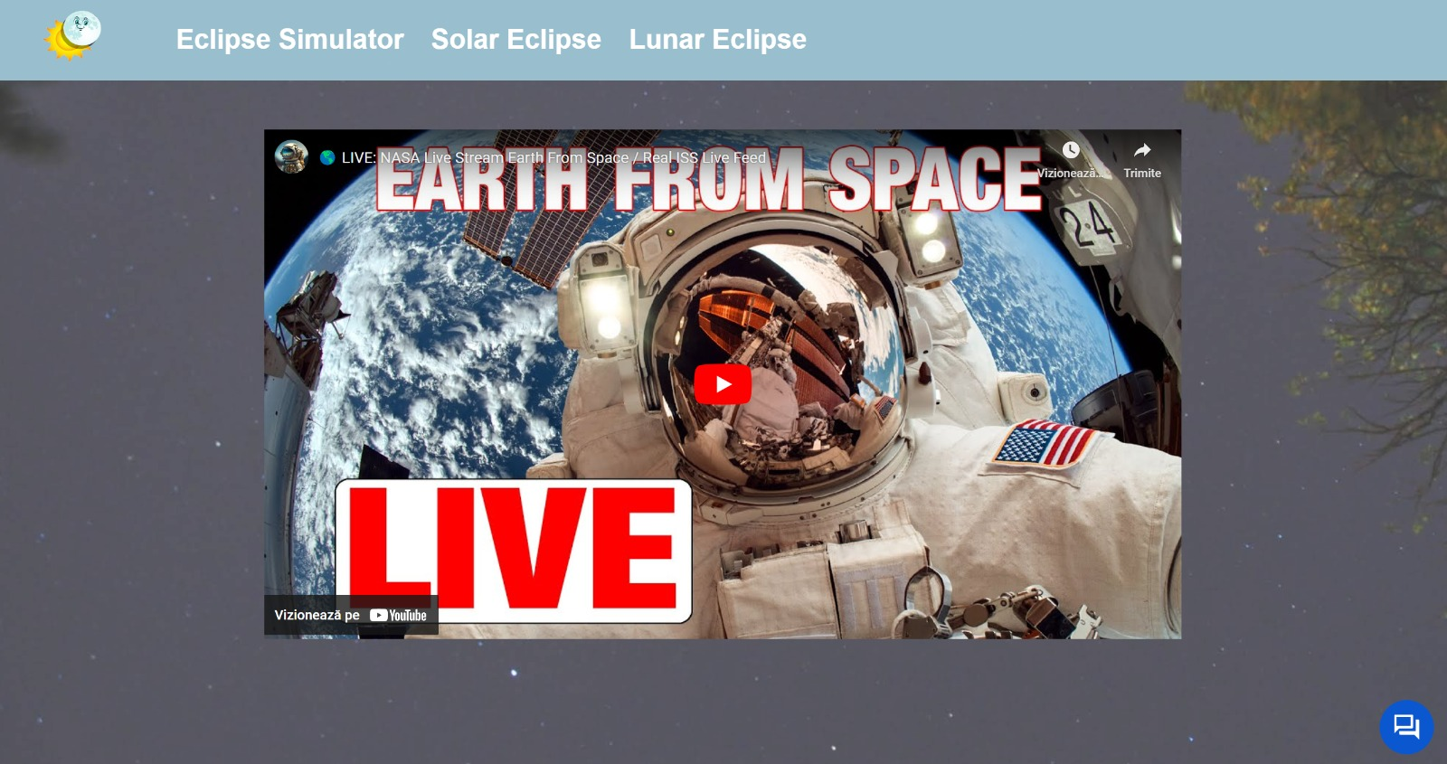
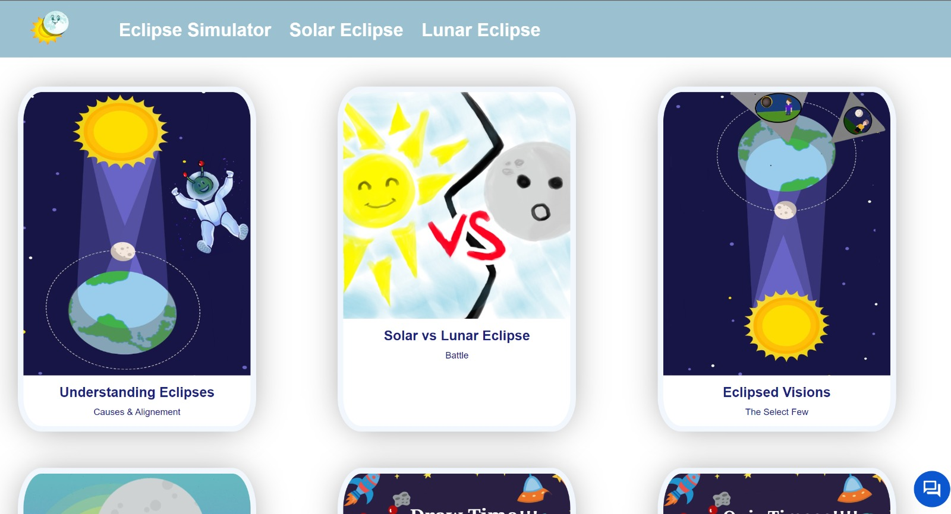
Proposed/Done

Slide 6

Future development
ChatBot should use more resources
VR experience
Feeds
Mobile application

Slide 7

Thank you !

